Slide 1
Chapter 4: Threads
Overview
Multithreading Models
Thread Libraries
Threading Issues
Operating System Examples
Windows XP Threads
Linux Threads
Notes:
‹#›

Slide 2
Objectives
To introduce the notion of a thread — a fundamental unit of CPU utilization that forms the basis of multithreaded computer systems
To discuss the APIs for the Pthreads, Win32, and Java thread libraries
To examine issues related to multithreaded programming

Slide 3
Thread Overview
Threads are mechanisms that permit an application to perform multiple tasks concurrently.
Thread is a basic unit of CPU utilization
Thread ID
Program counter
Register set
Stack
A single program can contain multiple threads
Threads share with other threads belonging to the same process
Code, data, open files…….

Slide 4
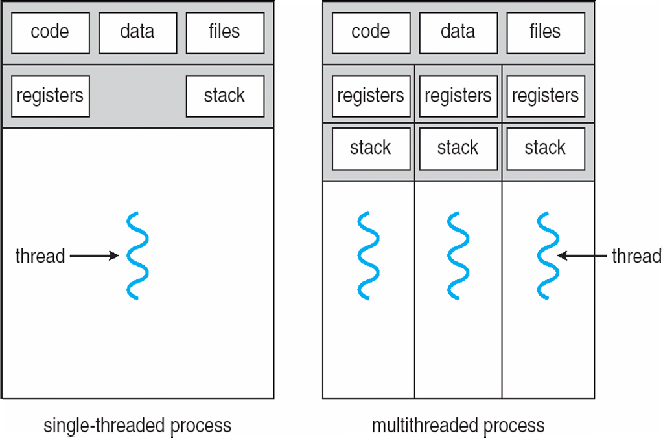
Single and Multithreaded Processes
Traditional (heavyweight) process has a single thread of control
heavyweight process
lightweight process
Notes:
‹#›

Slide 5
Threads in Memory
Memory is allocated for a process in segments or parts:
argv, environment
Stack for main thread
Stack for thread 1
Stack for thread 2
Stack for thread 3
Increasing virtual address
Heap
Un-initialized data
Initialized data
Text ( program code)
Thread 1 executing here
Main thread executing here
Thread 3 executing here
Thread 2 executing here
0000000
Notes:
Text: Made read-only so you don’t accidently modify your own instructions. Since many processes may be running the same program, this may be shared.
uninitialized data may be set to 000’s
‹#›

Slide 6
Threads
Threads specific
Attributes….
Threads share….
Global memory
Process ID and parent process ID
Controlling terminal
Process credentials (user )
Open file information
Timers
………
Thread ID
Thread specific data
CPU affinity
Stack (local variables and function call linkage information)
……

Slide 7
Benefits
Responsiveness Interactive application can delegate background functions to a thread and keep running
Resource Sharing Several different threads can access the same address space
Economy Allocating memory and new processes is costly. Threads are much ‘cheaper’ to initiate.
Scalability
Use threads to take advantage of multiprocessor architecture
Notes:
‹#›

Slide 8
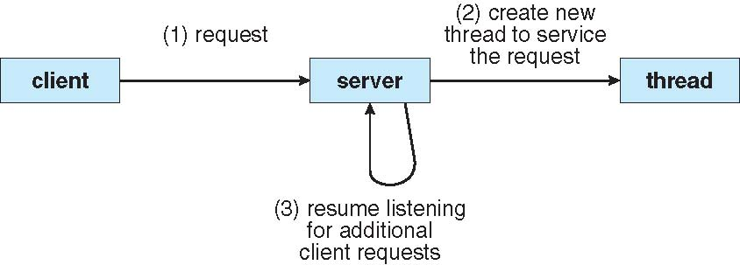
Multithreaded Server Architecture
thread
thread
thread
thread

Slide 9
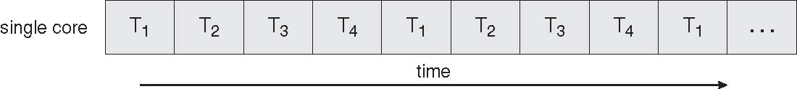
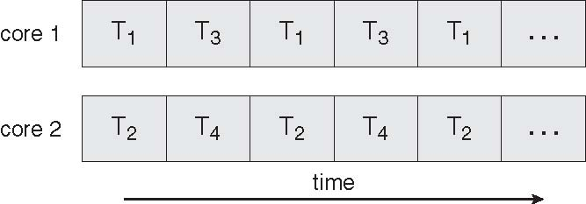
Concurrent Execution on a Single-core System
Multicore Programming
Parallel Execution on a Multicore System

Slide 10
Multicore Programming
Multicore systems putting pressure on programmers, challenges include
Dividing activities
What tasks can be separated to run on different processors
Balance
Balance work on all processors
Data splitting
Separate data to run with the tasks
Data dependency
Watch for dependences between tasks
Testing and debugging
Harder!!!!

Slide 11
Threads Assist Multicore Programming
thread
thread
Let threads on different CPUs
thread
thread

Slide 12
Multithreading Models
Support provided at either
User level -> user threads
Supported above the kernel and managed without kernel support
Kernel level -> kernel threads
Supported and managed directly by the operating system
What is the relationship between user and kernel threads?

Slide 13
User Threads
Thread management done by user-level threads library
Three primary thread libraries:
POSIX Pthreads
Win32 threads
Java threads
Notes:
‹#›

Slide 14
Kernel Threads
Supported by the Kernel
Examples
Windows XP/2000
Solaris
Linux
Tru64 UNIX
Mac OS X
Notes:
‹#›

Slide 15
Multithreading Models
User Thread – to - Kernel Thread
Many-to-One
One-to-One
Many-to-Many
Notes:
‹#›

Slide 16
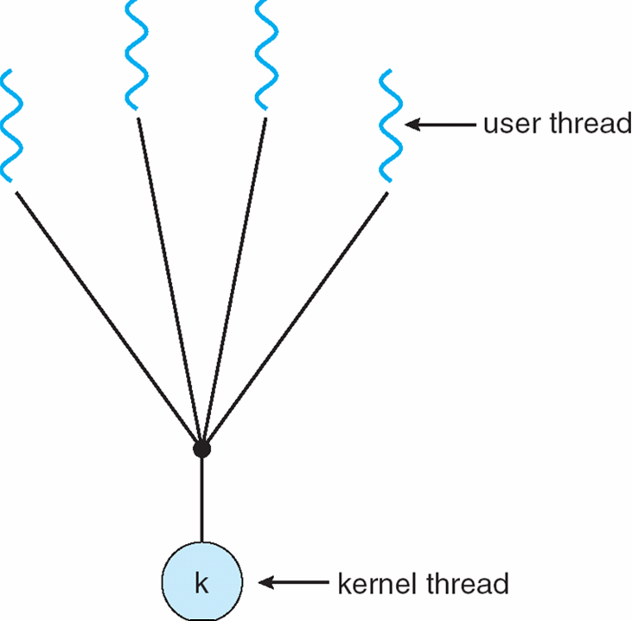
Many-to-One
Many user-level threads mapped to single kernel thread
Notes:
‹#›

Slide 17
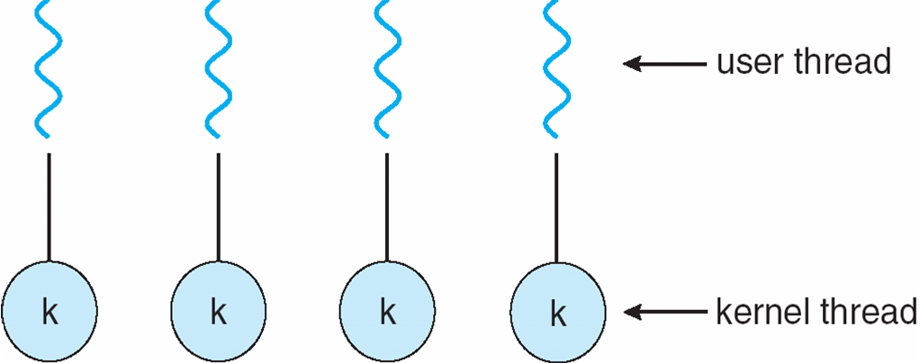
One-to-One
Each user-level thread maps to kernel thread
Examples
Windows NT/XP/2000
Linux
Notes:
‹#›

Slide 18
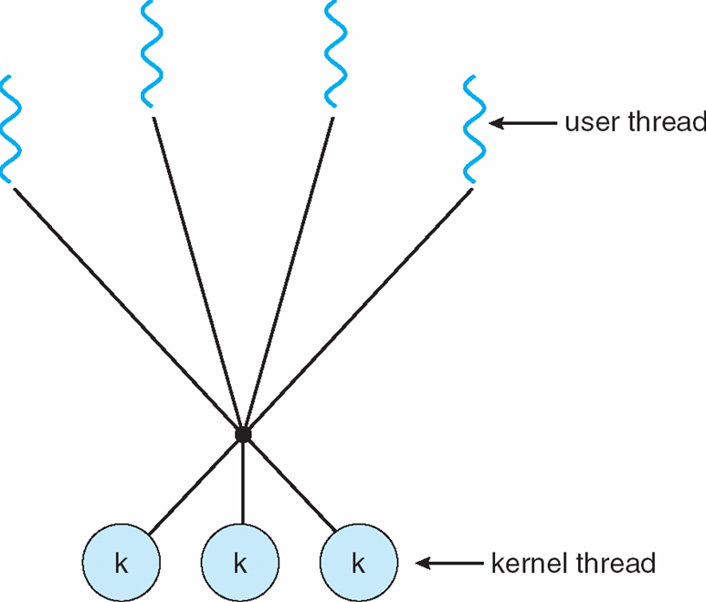
Many-to-Many Model
Allows many user level threads to be mapped to many kernel threads
Allows the operating system to create a sufficient number of kernel threads
Example
Windows NT/2000 with the ThreadFiber package
Notes:
‹#›

Slide 19
Thread Libraries
Thread library provides programmer with API for creating and managing threads
Two primary ways of implementing
Library entirely in user space
Kernel-level library supported by the OS
Three main thread libraries in use today:
POSIC Pthreads
Win32
Java

Slide 20
Thread Libraries
Three main thread libraries in use today:
POSIX Pthreads
May be provided either as user-level or kernel-level
A POSIX standard (IEEE 1003.1c) API for thread creation and synchronization
API specifies behavior of the thread library, implementation is up to development of the library
Win32
Kernel-level library on Windows system
Java
Java threads are managed by the JVM
Typically implemented using the threads model provided by underlying OS

Slide 21
POSIX Compilation on Linux
On Linux, programs that use the Pthreads API must be compiled with
–pthread or –lpthread

Slide 22
POSIX: Thread Creation
#include <pthread.h>
pthread_create (thread, attr, start_routine, arg)
returns : 0 on success, some error code on failure.

Slide 23
POSIX: Thread ID
#include <pthread.h>
pthread_t pthread_self()
returns : ID of current (this) thread

Slide 24
POSIX: Wait for Thread Completion
#include <pthread.h>
pthread_join (thread, NULL)
returns : 0 on success, some error code on failure.

Slide 25
POSIX: Thread Termination
#include <pthread.h>
Void pthread_exit (return_value)
Threads terminate in one of the following ways:
The thread's start functions performs a return specifying a return value for the thread.
Thread receives a request asking it to terminate using pthread_cancel()
Thread initiates termination pthread_exit()
Main process terminates

Slide 26
Thread Cancellation
Terminating a thread before it has finished
Having made the cancellation request, pthread_cancel() returns immediately; that is it does not wait for the target thread to terminate.
So, what happens to the target thread?
What happens and when it happens depends on the thread’s cancellation state and type.
Notes:
‹#›

Slide 27
Thread Cancellation
Thread attributes that indicate cancellation state and type
Two general states
Thread can not be cancelled.
PTHREAD_CANCEL_DISABLE
Thread can be cancelled
PTHREAD_CANCEL_ENABLE
Default
Notes:
‹#›

Slide 28
Thread Cancellation
When thread is cancelable, there are two general types
Asynchronous cancellation terminates the target thread immediately
PTHREAD_CANCEL_ASYNCHRONOUS
Deferred cancellation allows the target thread to periodically check if it should be cancelled
PTHREAD_CANCEL_DEFERRED
Cancel when thread reaches ‘cancellation point’
Notes:
‹#›

Slide 29
Thread Termination: Cleanup Handlers
Functions automatically executed when the thread is canceled.
Clean up global variables
Unlock and code or data held by thread
Close files
Commit or rollback transactions
Add and remove cleanup handlers based on thread logic
pthread_cleanup_push()
pthread_cleanup_pop()

Slide 30
Threading Issues
Semantics of fork() and exec() system calls
Signal handling
Thread pools
Thread safety
Thread-specific data
Notes:
‹#›

Slide 31
Semantics of fork() ,exec(), exit()
Does fork() duplicate only the calling thread or all threads?
Threads and exec()
With exec(), the calling program is replaced in memory. All threads, except the once calling exec(), vanish immediately. No thread-specific data destructors or cleanup handlers are executed.
Threads and exit()
If any thread calls exit() or the main thread does a return, ALL threads immediately vanish. No thread-specific data destructors or cleanup handlers are executed.
Notes:
‹#›

Slide 32
Semantics of fork() ,exec(), exit()
Threads and fork()
When a multithread process calls fork(), only the calling thread is replicated. All other threads vanish in the child. No thread-specific data destructors or cleanup handlers are executed.
Problems:
The global data may be inconsistent:
Was another thread in the process of updating it?
Data or critical code may be locked by another thread. That lock is copied into child process, too.
Memory leaks
Thread (other) specific data not available
Recommendation: In multithreaded application, only use fork() after exec()
Notes:
‹#›

Slide 33
Signal Handling
Signals are used in UNIX systems to notify a process that a particular event has occurred
A signal handler is used to process signals
Signal is generated by particular event
Signal is delivered to a process
Signal is handled
Options:
Deliver the signal to the thread to which the signal applies
Deliver the signal to every thread in the process
Deliver the signal to certain threads in the process
Assign a specific threa to receive all signals for the process
Notes:
‹#›

Slide 34
Thread Pools
Create a number of threads in a pool where they await work
Advantages:
Usually slightly faster to service a request with an existing thread than create a new thread
Allows the number of threads in the application(s) to be bound to the size of the pool
Notes:
‹#›

Slide 35
Thread Safety
A function is thread-safe if it can be safely invoked by multiple threads at the same time.
Example of a not safe function:
static int glob = 0;
static void Incr (int loops)
{
int loc, j;
for (j = 0; j<loops; j++ {
loc = glob;
loc++;
glob = loc;
}
}
Employs global or static values that are shared by all threads

Slide 36
Thread Safety
Ways to render a function thread safe
Serialize the function
Lock the code to keep other threads out
Only one thread can be in the sensitive code at a time
Lock only the critical sections of code
Only let one thread update the variable at a time.
Use only thread safe system functions
Make function reentrant
Avoid the use of global and static variables
Any information required to be safe is stored in buffers allocated by the call

Slide 37
Thread Specific Data
Makes existing functions thread-safe .
May be slightly less efficient than being reentrant
Allows each thread to have its own copy of data
Provides per-thread storage for a function
Useful when you do not have control over the thread creation process (i.e., when using a thread pool)
Notes:
‹#›

Slide 38
POSIX compliation
On Linux, programs that use the Pthreads API must be compiled with
–pthread. The effects of this option include the following:
_REENTRANT preprocessor macro is defined. This causes the declaration of a few reentrant functions to be exposed.
The program is linked with the libpthread library
(the equivalent of -lpthread )
The precise options for compiling a multithreaded program vary across implementations (and compilers).
From M. Kerrisk, The Linux Programming Interface
http://www.yolinux.com/TUTORIALS/LinuxTutorialPosixThreads.html
http://codebase.eu/tutorial/posix-threads-c/

Slide 39
Scheduler Activations
Both M:M and Two-level models require communication to maintain the appropriate number of kernel threads allocated to the application
Scheduler activations provide upcalls - a communication mechanism from the kernel to the thread library
This communication allows an application to maintain the correct number kernel threads
Notes:
‹#›

Slide 40
Threads vs. Processes
Advantages of multithreading
Sharing between threads is easy
Faster creation
Disadvantages of multithreading
Ensure threads-safety
Bug in one thread can bleed to other threads, since they share the same address space
Threads must compete for memory
Considerations
Dealing with signals in threads is tricky
All threads must run the same program
Sharing of files, users, etc

Slide 41
Operating System Examples
Windows XP Threads
Linux Thread
Notes:
‹#›

Slide 42
Windows XP Threads
Implements the one-to-one mapping, kernel-level
Each thread contains
A thread id
Register set
Separate user and kernel stacks
Private data storage area
The register set, stacks, and private storage area are known as the context of the threads
The primary data structures of a thread include:
ETHREAD (executive thread block)
KTHREAD (kernel thread block)
TEB (thread environment block)
Notes:
‹#›

Slide 43
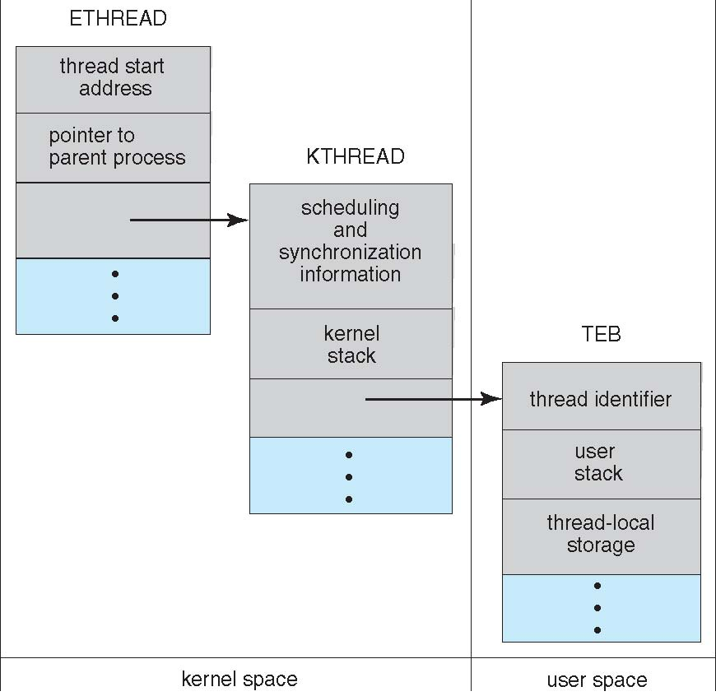
Windows XP Threads

Slide 44
Linux Threads
Linux refers to them as tasks rather than threads
Thread creation is done through clone() system call
clone() allows a child task to share the address space of the parent task (process)
Notes:
‹#›

Slide 45
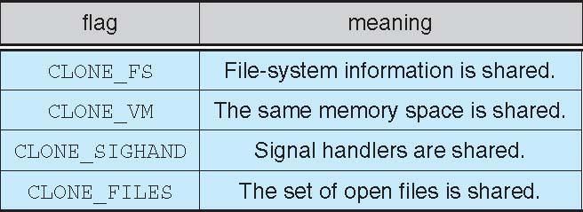
Linux Threads

Slide 46
Chapter 4: Threads
Overview
Multithreading Models
Thread Libraries
Threading Issues
Operating System Examples
Windows XP Threads
Linux Threads
Notes:
‹#›

Slide 47
End of Chapter 4
Notes:
‹#›

